Slide 1

Reverse Engineering
Выполнил: Цыпышев тимофей ИУ5-11б

Slide 2
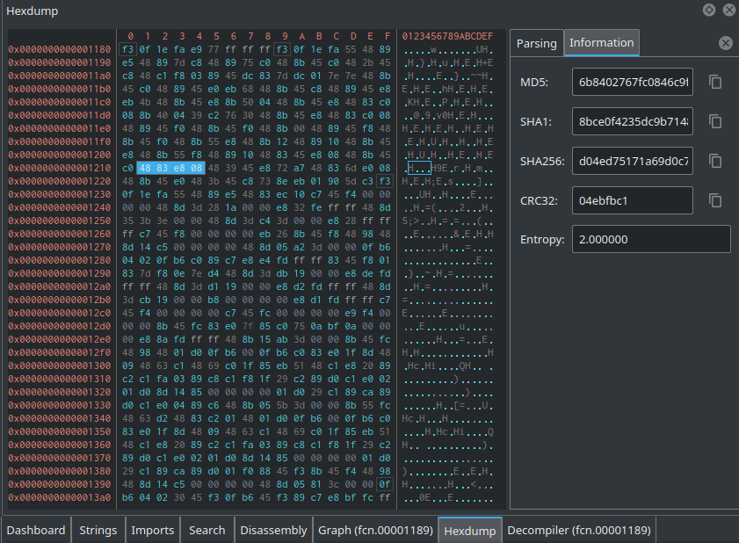
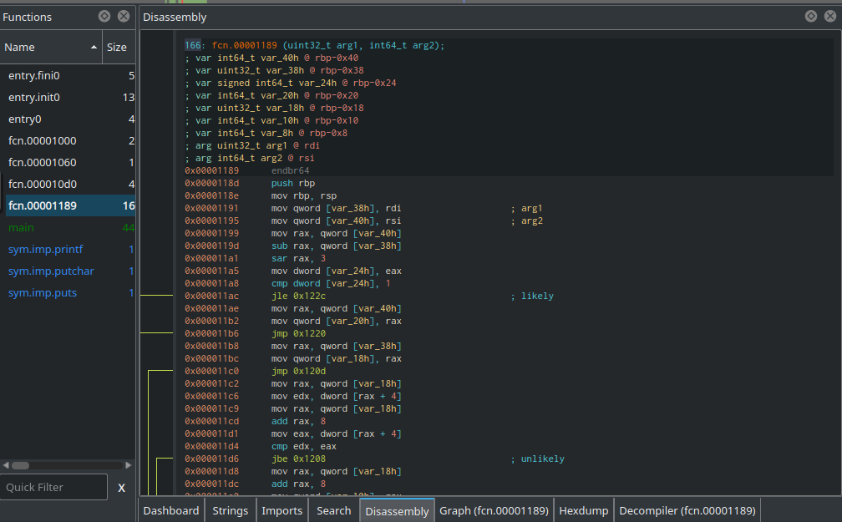
Introduction

Slide 3
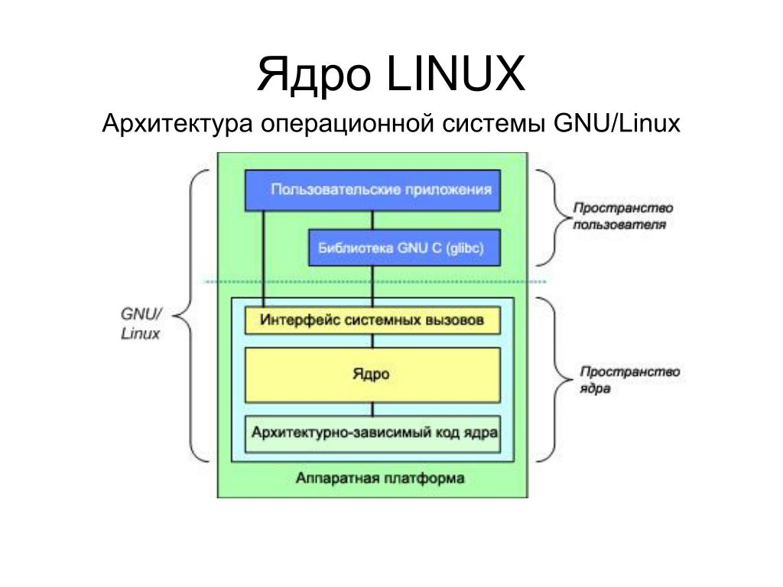
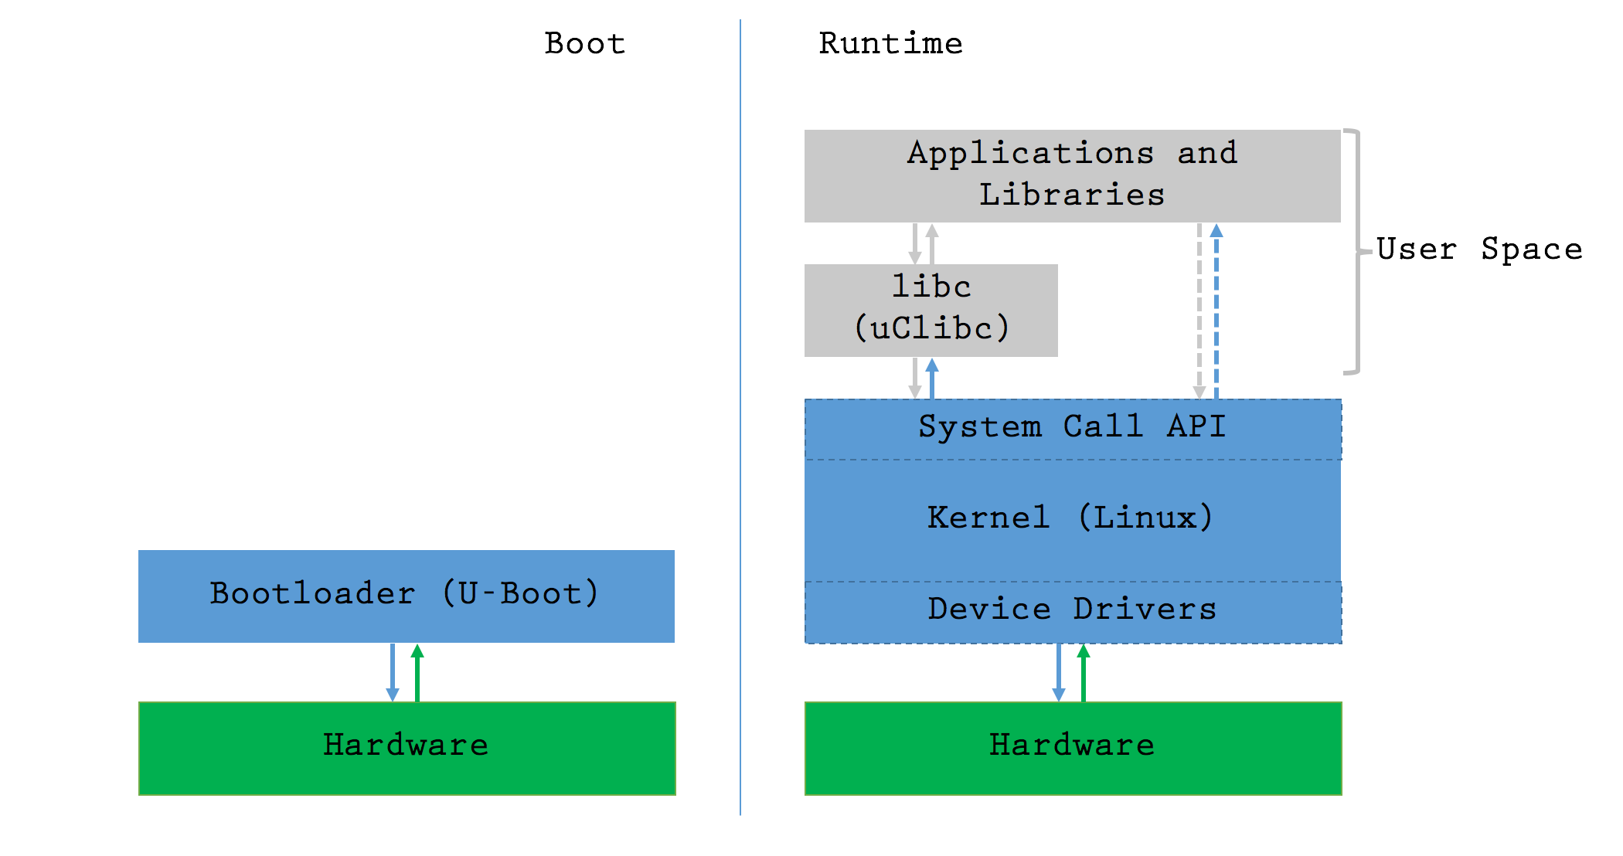
Introduction to the Architecture of Linux

Slide 4
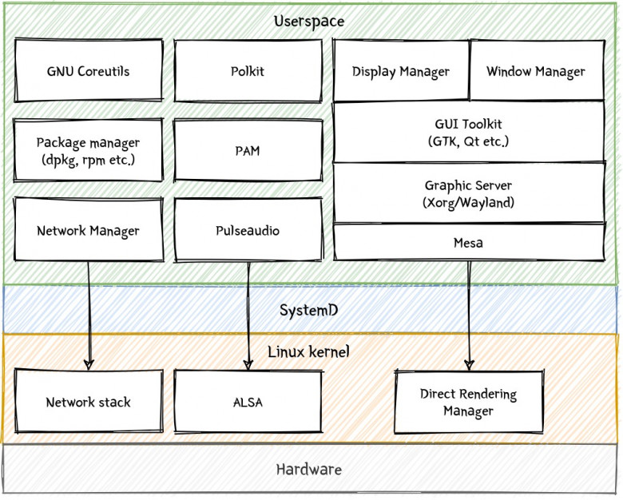
Learn more about the components
A few more details on each of the components:
Hardware
Linux Kernel
libc (“The C Library)
User Applications

Slide 5
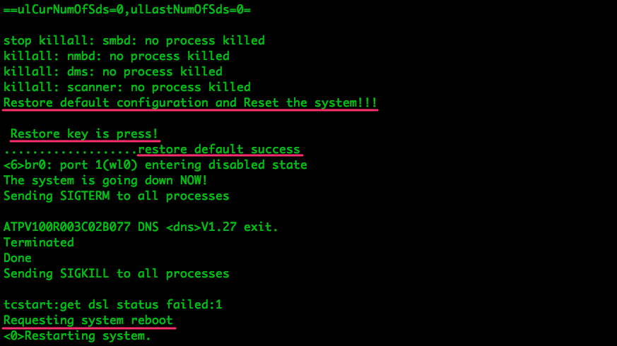
Kernel Source Code

Slide 6
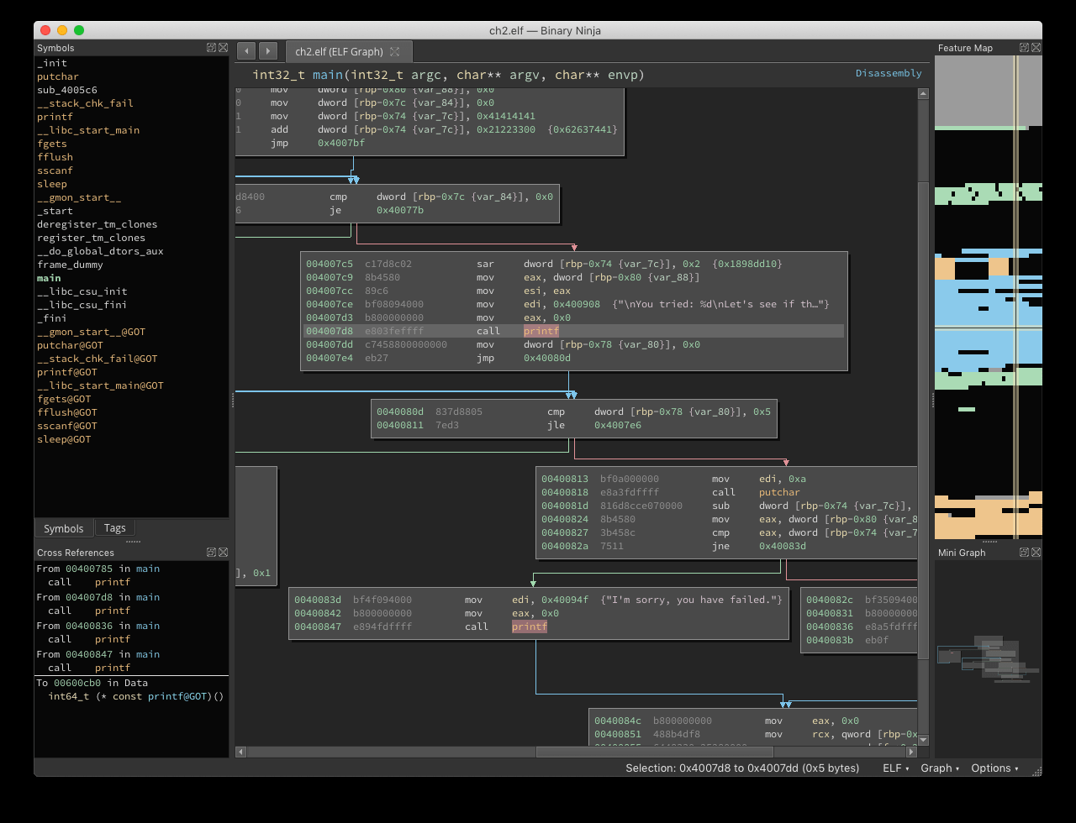
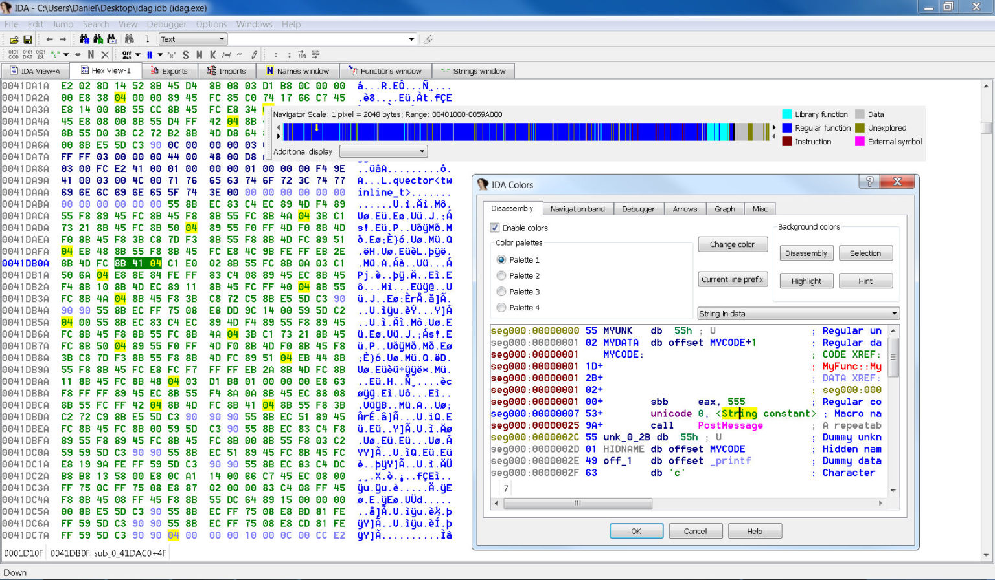
Binary Disassembly

Slide 7
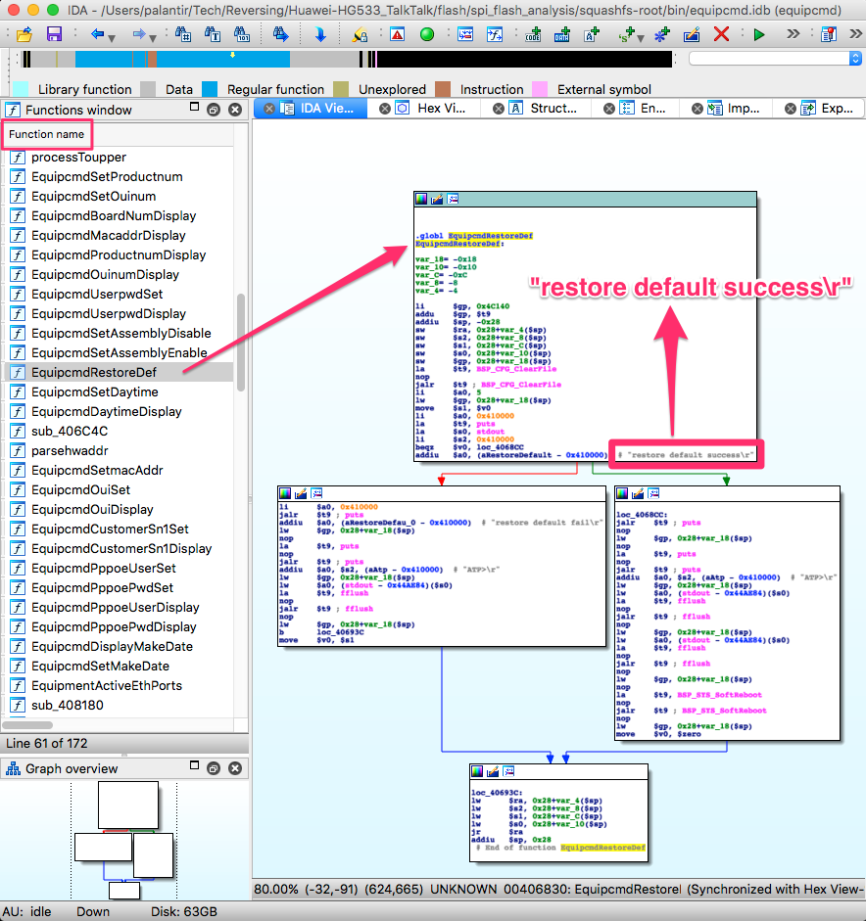
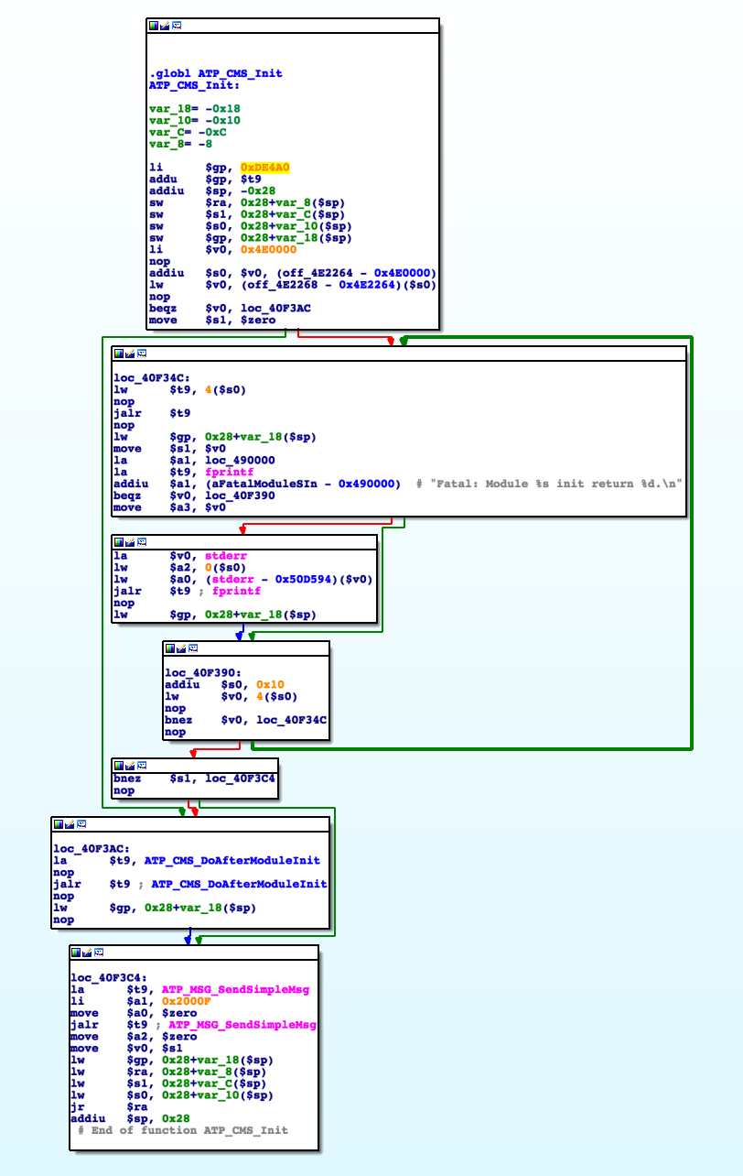
A little bit about disassemblers

Slide 8
Example of User Space Binary Disassembly
~/Tech/Reversing/Huawei-HG533_TalkTalk/router_filesystem
$ grep -i -r "restore default success" .
Binary file ./bin/cli matches
Binary file ./bin/equipcmd matches
Binary file ./lib/libcfmapi.so matches

Slide 9

Questions???

Slide 10

Thanks for watching

